Slide 1

Introduction to CSS
Cascading Style sheet

Slide 2
What is CSS?
CSS stands for Cascading Style Sheets
It is used to style and design HTML web pages
CSS controls:
Layout (positioning of elements)
Colors (text, background, borders)
Fonts & Text styling
Spacing and sizes (margins, padding, width, height)
CSS separates content (HTML) from presentation (design)

Slide 3
Types of CSS
Inline CSS
Written directly inside an HTML element using the style attribute
Internal CSS
Written inside <style> tag in the HTML <head>
External CSS
Written in a separate .css file and linked using <link> tag

Slide 4
CSS Priority (Order of Precedence)
If multiple styles are applied, CSS decides which one to apply based on priority:
Inline CSS (highest priority)
Internal CSS
External CSS (lowest priority)
The rule with higher specificity wins
The last rule written (if same specificity) overrides previous ones
!important overrides all styles

Slide 5
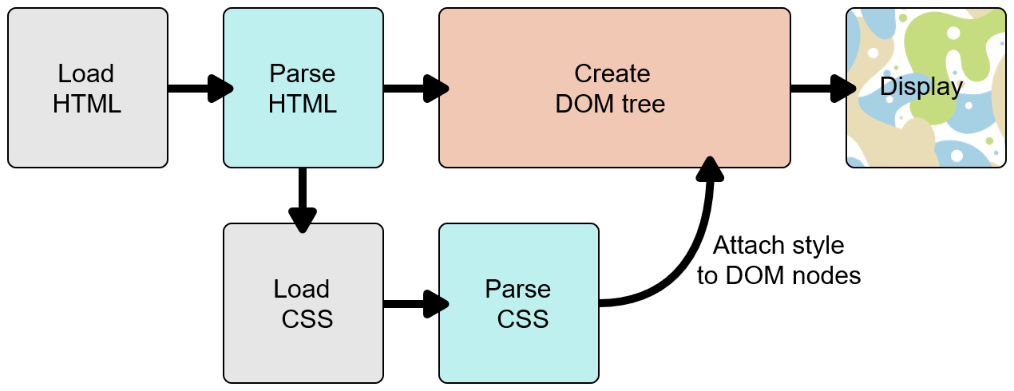
How_browsers_load_websites

Slide 6
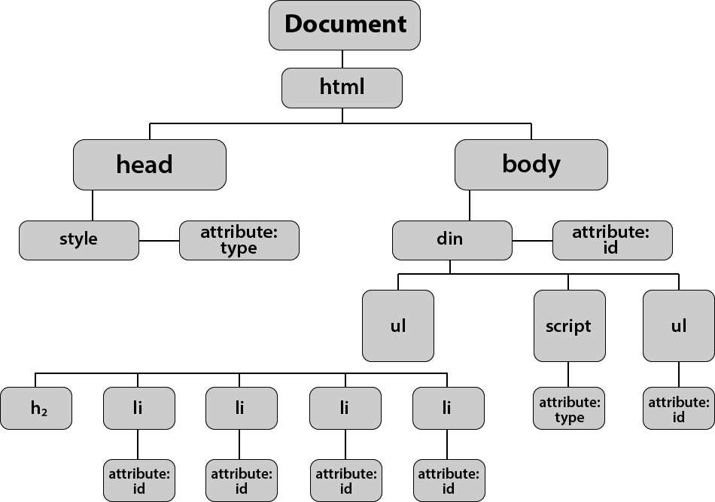
DOM Tree

Slide 7
CSS Selectors, Priority of Selectors
When multiple selectors target the same element:
Inline styles (style="") → Highest
ID selector (#id)
Class selector (.class) / Attribute selector
Type selector (p, h1, div)
Universal selector (*) → Lowest
Grouping selectors: Apply same styles to multiple elements.
Descendant selector (space ): All nested children. div p{ }
Child Selector (>) : Selects only the direct child elements. Syntax: parent > child
Pseudo-classes: Style special states (:hover, :first-child, :last-child, etc.).
Combinators :- home work

Slide 8
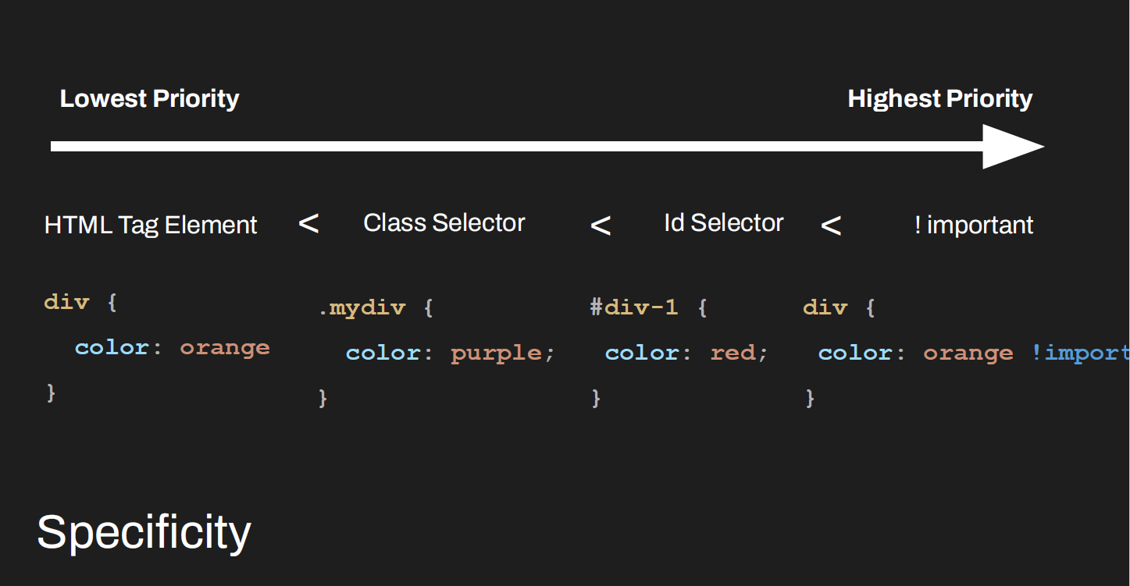
Specificity

Slide 9
CSS Properties
color → text color
background-color → background color
font-size → size of text (px, em, rem, %)
font-family → typeface (Arial, Verdana, sans-serif)
line-height → space between lines of text
text-align → left, right, center, justify
text-decoration → underline, overline, none
text-transform → uppercase, lowercase, capitalize
https://developer.mozilla.org/en-US/docs/Web/CSS/Properties
Try to take internet help mdn documentation or w3schools

Slide 10
CSS Box Model
Content → actual text, image, or data
Padding → space between content & border
Border → surrounds padding and content
Margin → space between the element and other elements
Height-> height of box
Width->width of box
https://www.w3schools.com/css/css_boxmodel.asp

Slide 11
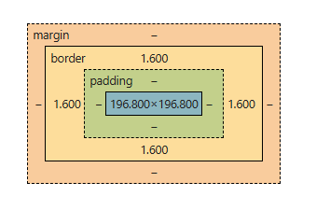
Box

Slide 12
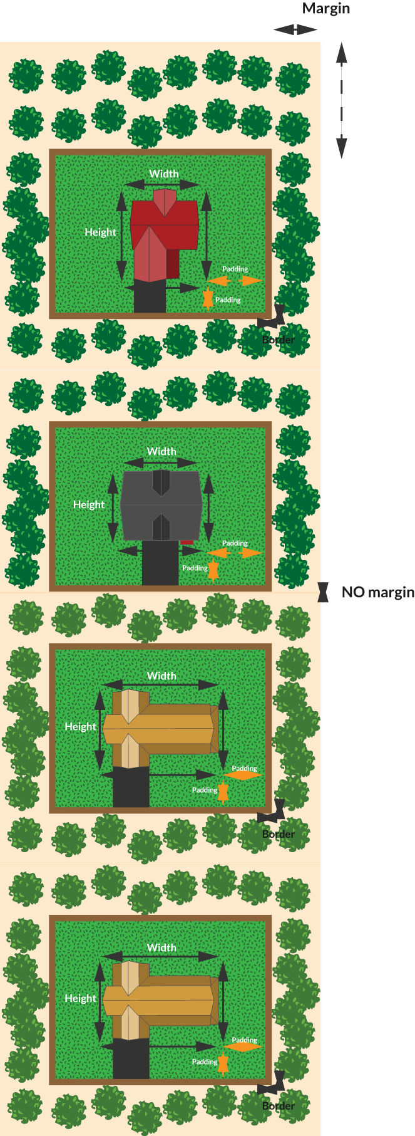

Slide 13
Colors and Linear Gradient and opacity
Names color:- red green blue etc
Hexadicimal , start with # :- #4842f5 etc
rgb (Red, Green, Blue) , Each channel: 0–255, alpha transparency rgba()
Opacity:-transparency , 0 to 1
LG:-most used for overlays and cool backgrounds
background: linear-gradient(to right, red, blue);
background: linear-gradient(rgba(0,0,0,0.6), rgba(0,0,0,0));
Gradient on Image (Overlay):-
background: linear-gradient(rgba(0,0,0,0.5), rgba(0,0,0,0.5)),
url("flower.jpg") no-repeat center/cover;

Slide 14
Overflow, Background, Object Fit
Background:-
https://css-tricks.com/almanac/properties/b/background/
background: color image position / size repeat attachment origin clip;
Overflow:-
https://developer.mozilla.org/en-US/docs/Web/CSS/overflow
Objectfit:-
https://www.w3schools.com/css/css3_object-fit.asp

Slide 15
Box-shadow and box-radius and important
+ve and –ve value ( x , y , spread , color)
box-shadow: 0px 0px 10px rgba(0,0,0,0.6);
border-radius: 10%;
p {
background-color: yellow !important;
}
//highest specificity
Important>id>class>tag>*

Slide 16
Explore yourself
Float property
Display :inline , block , inline-blocks

Slide 17
positions

Slide 18
CSS Units – px vs %
px (Pixels):
Fixed size
Does not change with screen size
Example: width: 200px;
% (Percentage):
Relative to parent element
Makes design responsive
Example: width: 50%;

Slide 19
flexbox

Slide 20
Medium clone

Slide 21
responsivness

Slide 22
Animations

